Slide 1
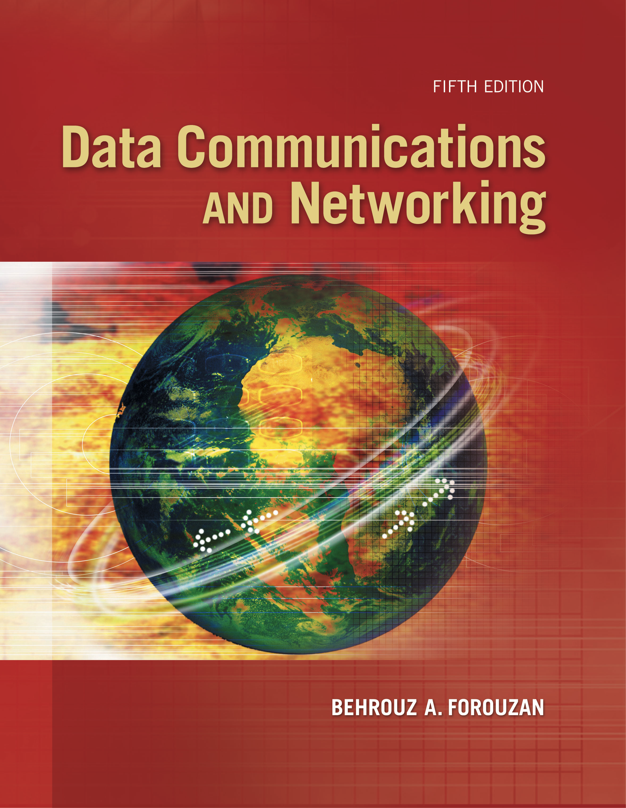
Computer Networks
Unicast Routing
S.V.Jansi Rani
Associate Professor / CSE

Slide 2
AGENDA
Routing Algorithms
Distance Vector
Link state Routing
Path Vector Routing
Routing Protocols
Routing Information Protocol RIP
Open Shortest Path First OSPF
Border Gateway Protocol BGP

Slide 3
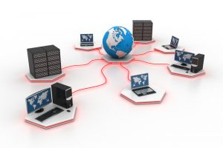


Slide 4
ROUTING
A routing table can be either static or dynamic. A static table is one with manual entries.
A dynamic table is one that is updated automatically when there is a change somewhere in the Internet.
A routing protocol is a combination of rules and procedures that lets routers in the Internet inform each other of changes.

Slide 5
General Idea
In unicast routing, a packet is routed, hop by hop, from its source to its destination by the help of forwarding tables.
The source host needs no forwarding table because it delivers its packet to the default router in its local network.
The destination host needs no forwarding table either because it receives the packet from its default router in its local network.
This means that only the routers that glue together the networks in the internet need forwarding tables.

Slide 6
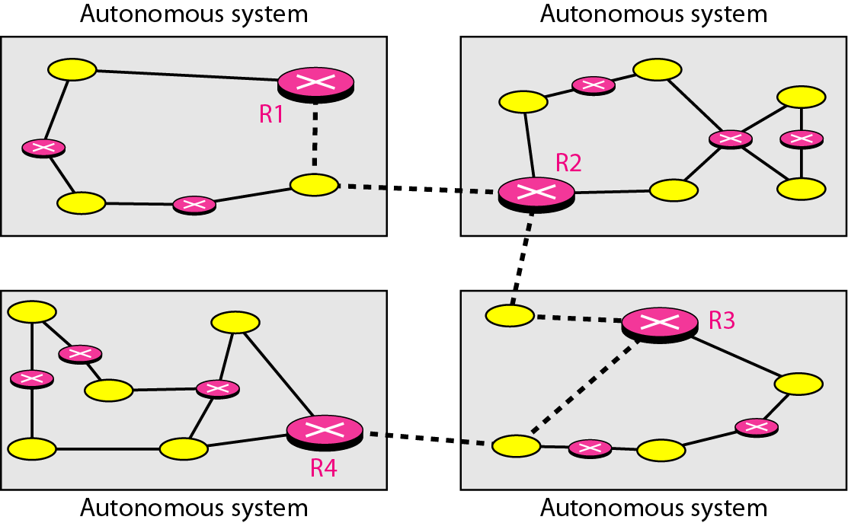
Autonomous systems

Slide 7
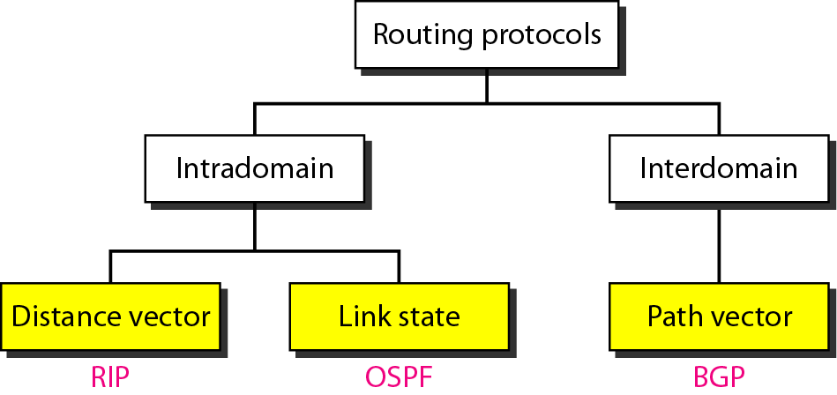
Popular routing protocols

Slide 8
Least-Cost Routing
When an internet is modeled as a weighted graph, one of the ways to interpret the best route from the source router to the destination router is to find the least cost between the two.
Least cost among all possible routes.

Slide 9
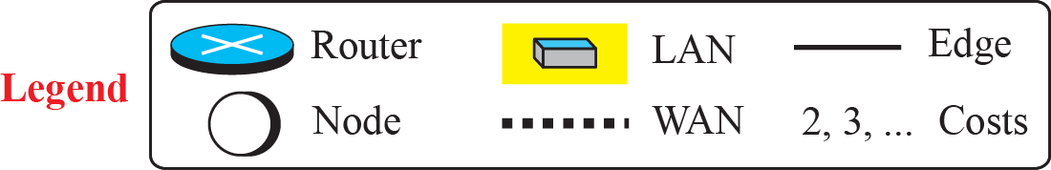
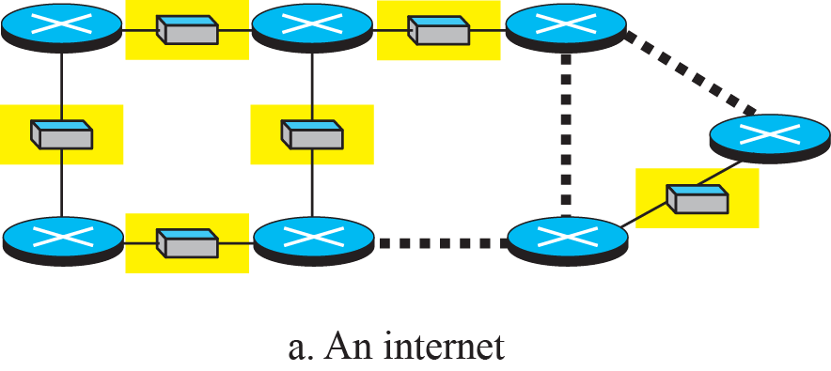
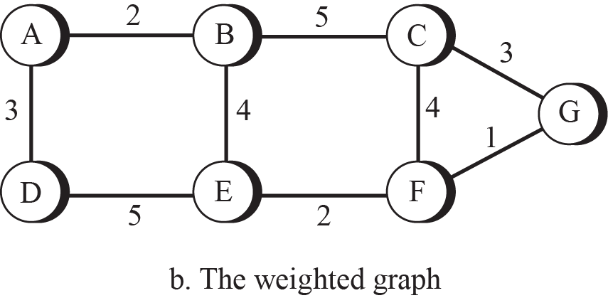
An internet and its graphical representation

Slide 10
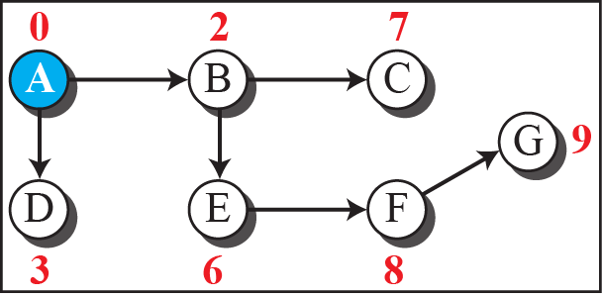
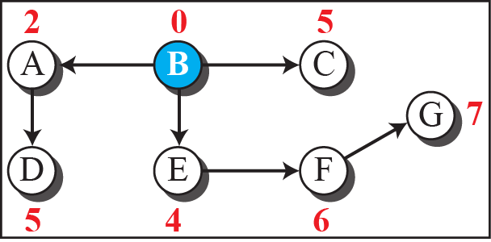
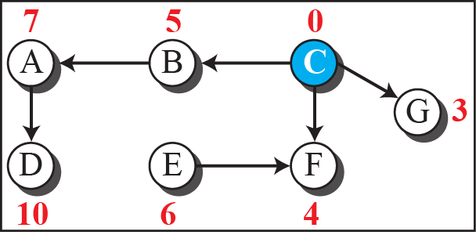
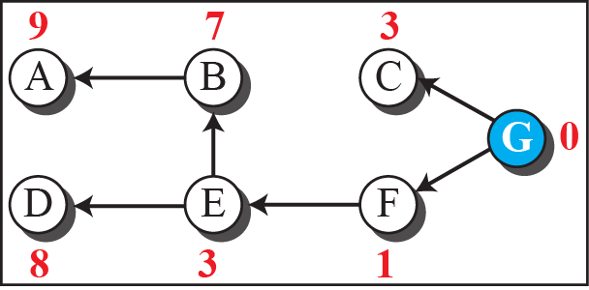
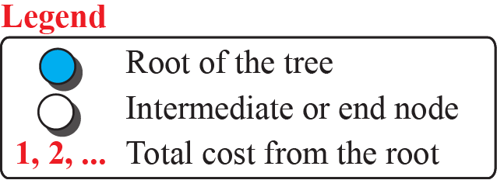
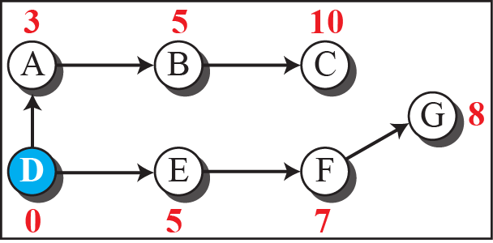
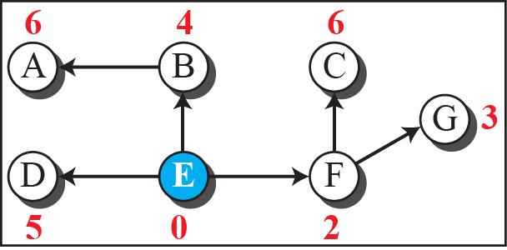
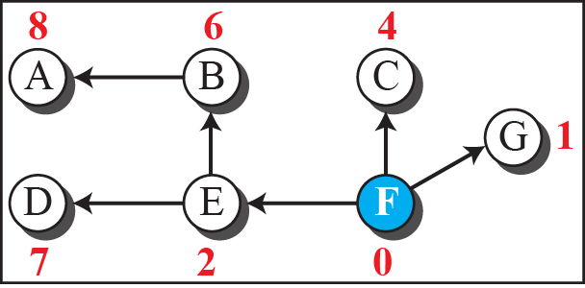
Least-cost trees for nodes in the internet

Slide 11
ROUTING ALGORITHMS
Several routing algorithms have been designed in the past.
The differences between these methods are in the way they interpret the least cost and the way they create the least-cost tree for each node.

Slide 12
Distance-Vector Routing
The distance-vector (DV) routing - find the best route.
Each node creates is its own least-cost tree with the rudimentary information it has about its immediate neighbors.
The incomplete trees are exchanged between immediate neighbors to make the trees more and more complete and to represent the whole internet.
Router continuously tells all of its neighbors what it knows about the whole internet (although the knowledge can be incomplete).

Slide 13

Note
In distance vector routing, each node shares its routing table(whole internet) with its immediate neighbors periodically and when there is a change.

Slide 14
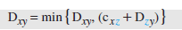
Bellman Ford Algorithm –Least Cost
To find the least cost (shortest distance) between a source node, x, and a destination node, y, through some intermediary nodes (a, b, c, . . .) when the costs between the source and the intermediary nodes and the least costs between the intermediary nodes and
the destination are given.
The following shows the general case in which Dxy is the shortest
distance and cij is the cost between nodes i and j.

Slide 15
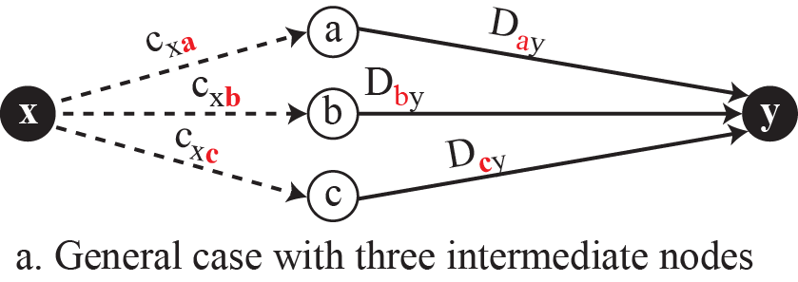
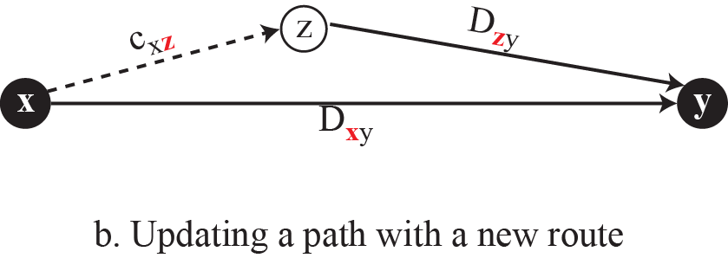
Graphical idea behind Bellman-Ford equation

Slide 16
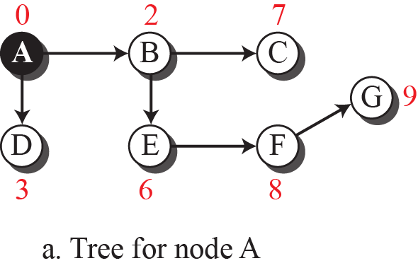
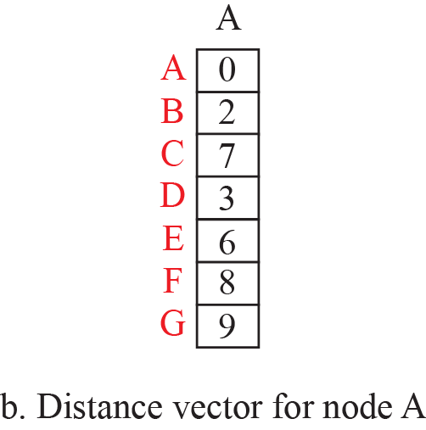
The distance vector corresponding to a tree

Slide 17
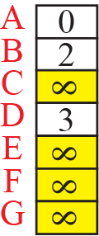
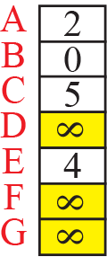
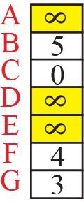
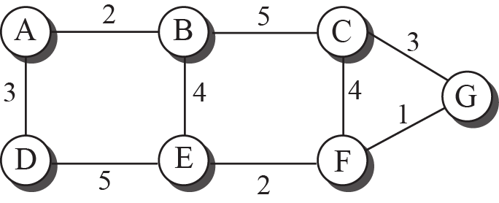
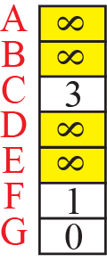
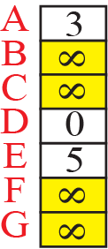
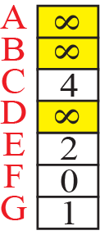
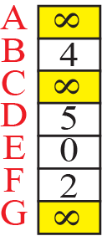
The first distance vector for an internet

Slide 18
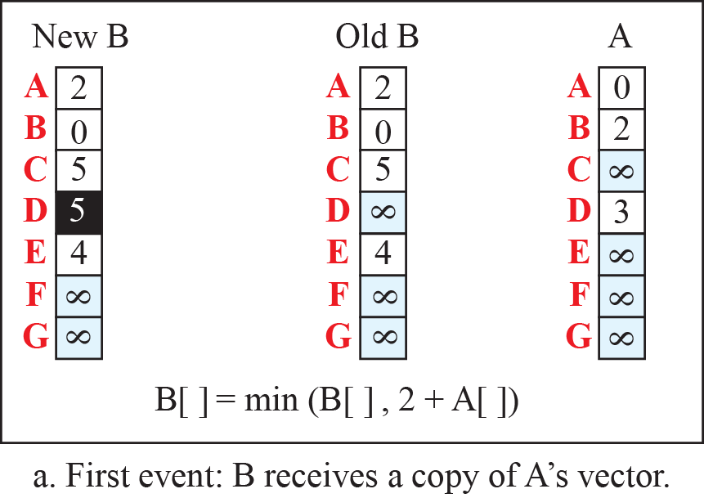
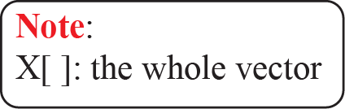
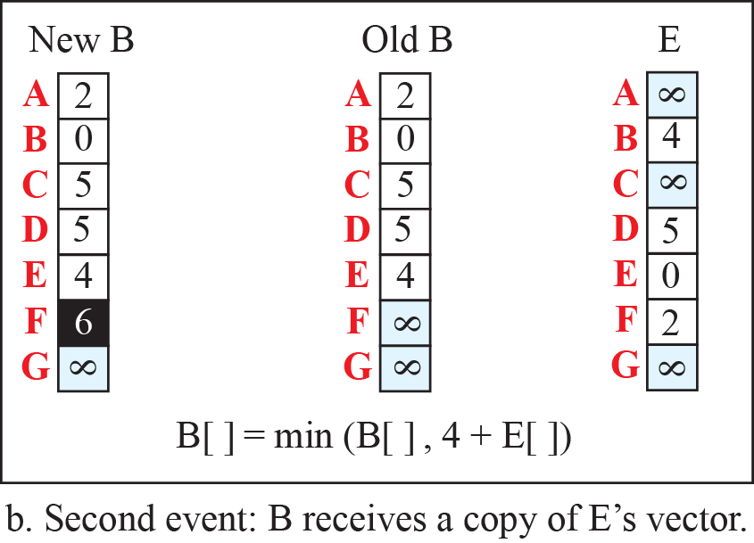
Updating distance vectors

Slide 19
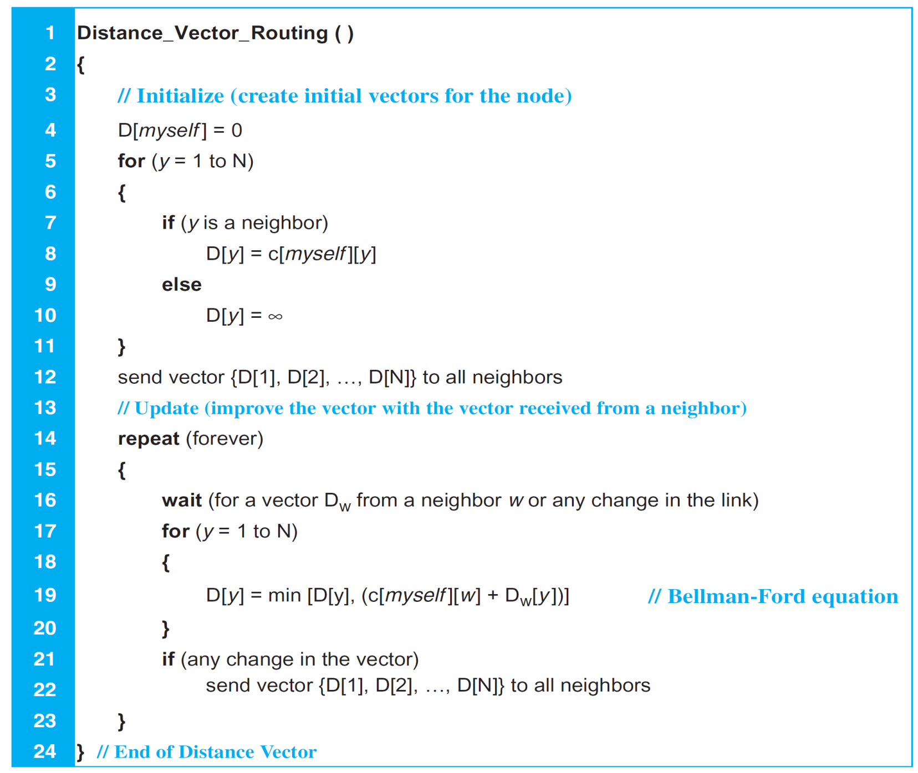
Distance-Vector Routing Algorithm for A Node

Slide 20
When to share
Periodic update – every 30s
Triggered update
1. A node receives a table from a neighbour, resulting in changes in its own table after updating.
2. A node detects some failure in the neighbouring links which results in a distance change to infinity.

Slide 21
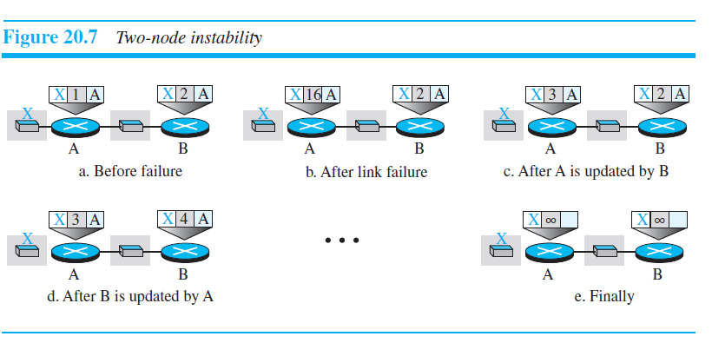
Two Node Instability (Count to infinity problem)

Slide 22
Solution
Split horizon – don’t send routes learnt from neighbour back to it
Split horizon with poison reverse –
corresponding protocol uses a timer, and if there is no news about a route, the node deletes the route from its table.
send routes learnt from neighbour back to it with infinity value (it is better to get bad news than no news)

Slide 23
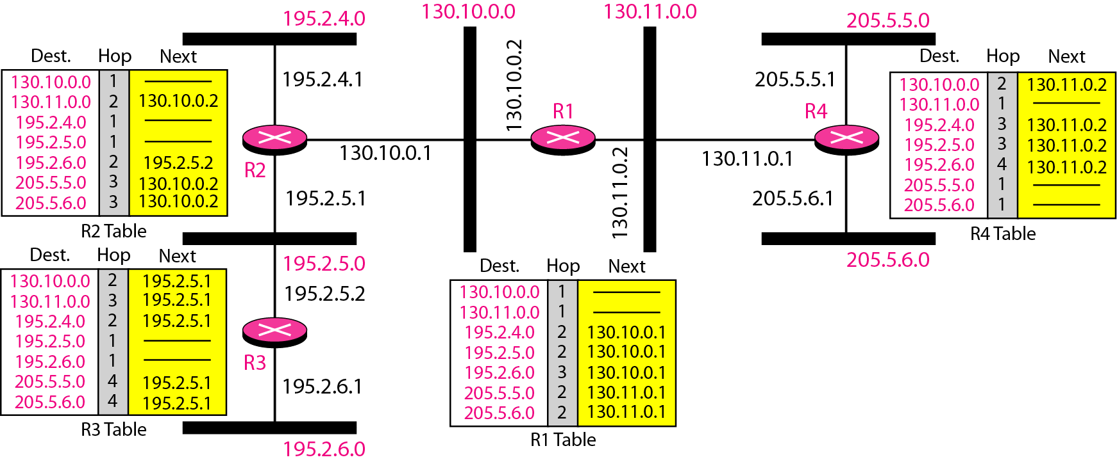
Example of a domain using RIP

Slide 24
Link-State Routing
Link-state to define the characteristic of a link (an edge) that represents a network in the internet.
Cost associated with an edge defines the state of the link.
Links with lower costs are preferred to links with higher costs; if the cost of a link is infinity, it means that the link does not exist or has been broken.

Slide 25
Note
In link state routing, each node shares(floods) about its immediate neighbors information to the whole network.

Slide 26
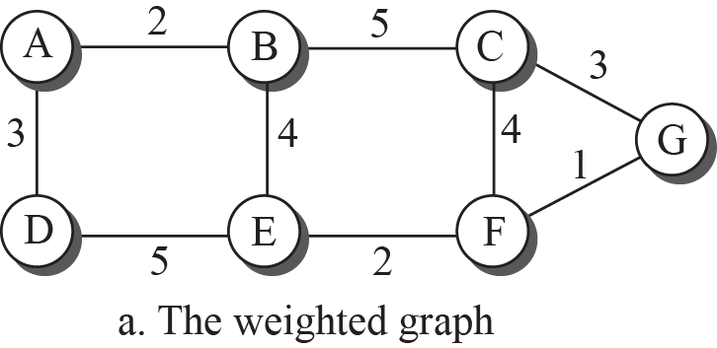
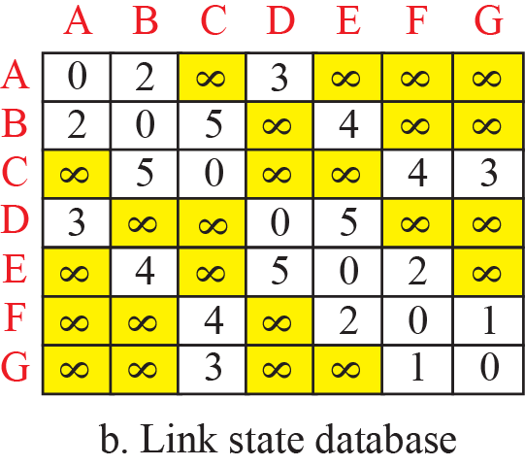
Example of a link-state database (LSDB)

Slide 27
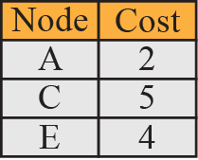
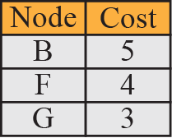
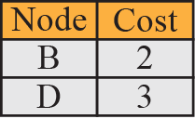
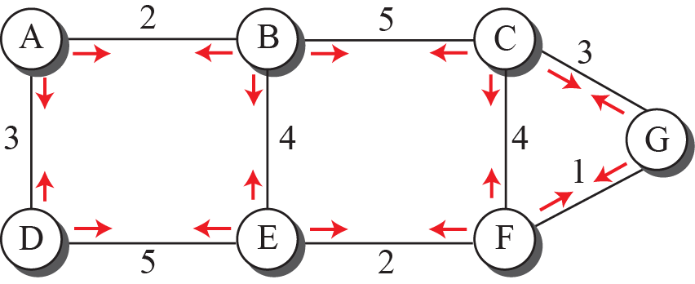
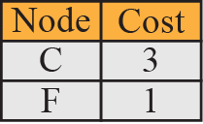
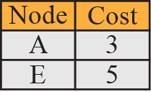
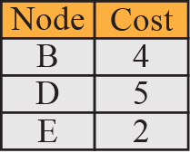
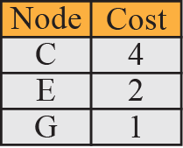
LSPs created and sent out by each node to build LSDB

Slide 28
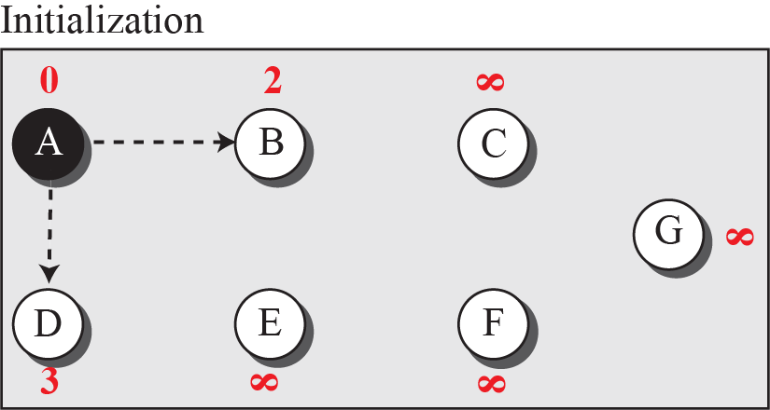

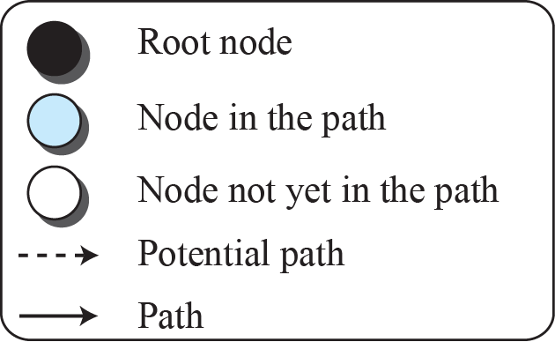
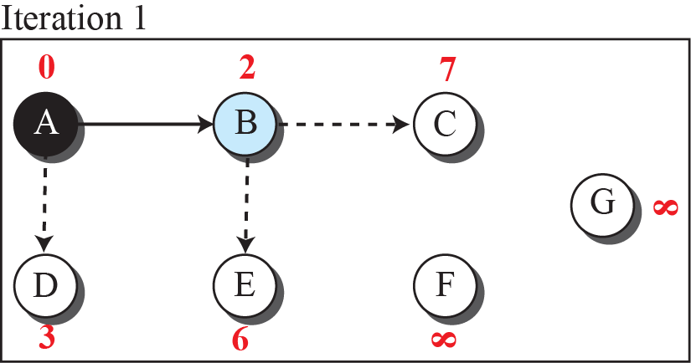
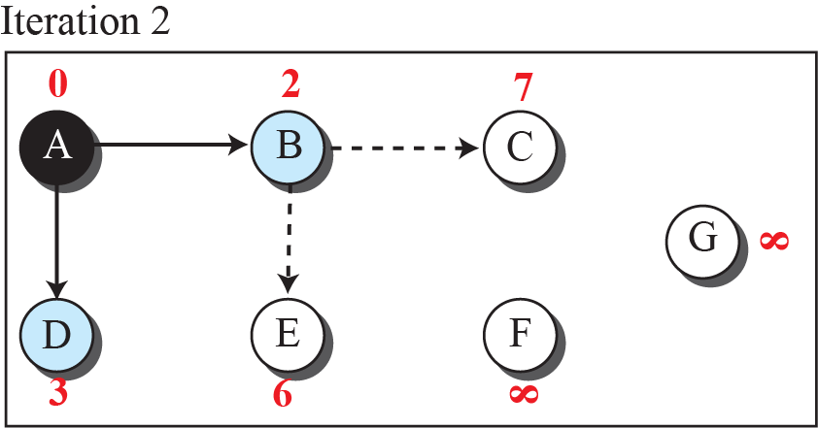
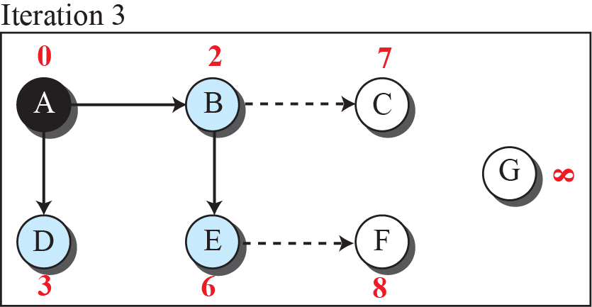
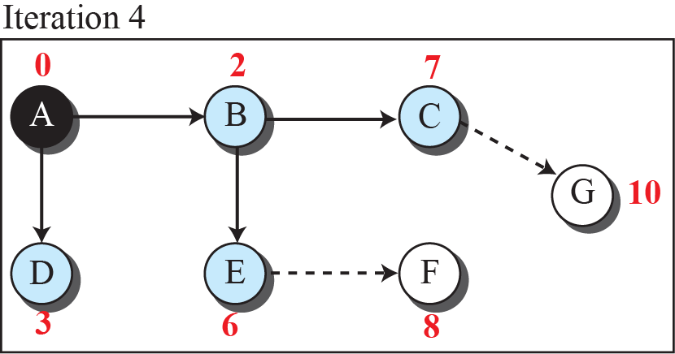


Least-cost tree

Slide 29

Link State Knowledge –Another Example

Slide 30

Link State Knowledge

Slide 31
When to share
Periodic update – every 60m to 2 hr
Change in topology

Slide 32

Flooding of LSP

Slide 33

Dijkstra Algo

Slide 34

Shortest path
Permanent List | Tentative list
Empty | A(0)
A(0) | B(5)C(2)D(3)
A(0) C(2) | B(5)D(3) E(6)
A(0) C(2) D(3) | B(5) E(6)
A(0) C(2) D(3) B(5) | E(6)
A(0) C(2) D(3) B(5)E(6)

Slide 35

Routing table
Permanent List | Tentative list
Empty | A(0)
A(0) | B(5)C(2)D(3)
A(0) C(2) | B(5)D(3) E(6)
A(0) C(2) D(3) | B(5) E(6)
A(0) C(2) D(3) B(5) | E(6)
A(0) C(2) D(3) B(5)E(6)

Slide 36

Dijkstra’s Algorithm

Slide 37
Path-Vector Routing
Both link-state and distance-vector routing are based on the least-cost goal –intra domain
Least-cost goal, applied by LS or DV routing, does not allow a sender to apply specific policies to the route a packet may take.
To respond to these demands, a third routing algorithm, called path-vector (PV) routing has been devised – interdomain routing

Slide 38








Path vectors made at booting time

Slide 39






Spanning trees in path-vector routing

Slide 40



Updating path vectors

Slide 41

Path-vector algorithm for a node

Slide 42

Initial routing tables in path vector routing

Slide 43


Stabilized tables for three autonomous systems

Slide 44
UNICAST ROUTING PROTOCOLS
Routing Information Protocol RIP - distance-vector algorithm
Open Shortest Path First OSPF -link-state algorithm
and Border Gateway Protocol BGP -path-vector algorithm

Slide 45

Internet structure

Slide 46
Hierarchical Routing
Single Protocol – not possible in internet - scalability, administrative issure
RP in AS - Intra-AS routing protocol, intradomain routing protocol, or interior gateway protocol -IGP
Global routing protocol - inter-AS routing protocol,
interdomain routing protocol, or exterior gateway protocol (EGP)

Slide 47
Autonomous System
Categorized – way they connect
Stub AS – connected to only one AS – data traffic can be initiated or terminated. Eg: customer nw
Multihomed AS – A multihomed AS can have more than one connection to other
ASs, but it does not allow data traffic to pass through it.– don’t allow traffic but provides service Eg: customer who use more than one provider
Transient AS – A transient AS is connected to more than one other AS and also
allows the traffic to pass through Eg: provider and backbone nw

Slide 48
Routing Information Protocol
RIP was started as part of the Xerox Network System (XNS), but it was the Berkeley Software Distribution (BSD) version of UNIX that helped make the use of RIP widespread.
Uses distance vector
1. RIP routers advertise the cost of reaching different
Networks (destination resides) instead of reaching other nodes in a theoretical graph
2. Cost here is hop count (max 15)

Slide 49




Hop counts in RIP

Slide 50
Forwarding tables

Slide 51


RIP message format
RIP port no - 520

Slide 52
RIP Algorithm
Instead of sending only distance vectors, a router needs to send the whole contents of its forwarding table in a response message.
The receiver adds one hop to each cost and changes the next router field to the address of the sending router. We call each route in the modified forwarding table the received route and each route in the old forwarding table the old route.
The received router selects the old routes as the new ones except in the following three cases:
1. New entry -added to the route.
2. Less cost - selected as the new one.
3. Cost RR > old route, next hop –same - selected as the new one. This is the case where the route was actually advertised by the same router in the past, but now the situation has been changed
RIP Timers
Periodic Timer –update
Expiration Timer – 180 s –validity of route – receives update – no response – makes 16
Garbage collection Timer – before purging from RT -120s

Slide 53



Example of an autonomous system using RIP (Part I)

Slide 54


Example of an autonomous system using RIP (Part II)

Slide 55
Open Shortest Path First
Open Shortest Path First (OSPF) is also an intradomain routing protocol
Cost – different type of service such as RTT, throughput– weights will vary

Slide 56

Metric in OSPF

Slide 57




Forwarding tables in OSPF

Slide 58

Areas in an autonomous system

Slide 59


Five different LSPs (Part I)

Slide 60



Five different LSPs (Part II)

Slide 61




OSPF message formats (Part I)
Attention
Type 1 –Hello by router
Type 2- DB description as response – LSDB
Type 3 – LS Request
Type 4 – LS update – 5 diff links
Type 5 – LS Ack

Slide 62




OSPF message formats (Part II)
Attention

Slide 63
Border Gateway Protocol
The Border Gateway Protocol version 4 (BGP4) is the only interdomain routing protocol used in the Internet today.
BGP4 is based on the path-vector algorithm - provide information about the reachability of networks in the Internet.

Slide 64


A sample internet with four ASs

Slide 65





eBGP operation

Slide 66






Combination of eBGP and iBGP sessions in our internet

Slide 67




Finalized BGP path tables (Part I)

Slide 68



Finalized BGP path tables (Part II)

Slide 69



Finalized BGP path tables (Part III)

Slide 70




Forwarding tables after injection from BGP (Part I)

Slide 71





Forwarding tables after injection from BGP (Part II)

Slide 72


Format of path attribute
Type
1: ORIGIN
2: AS_PATH
3: NEXT_HOP
4:MULTI_EXIT_DISC
5: LOCAL_PREF
6: ATOMIC_AGGREGATE
7: AGGREGATOR

Slide 73


Flow diagram for route selection

Slide 74





BGP messages

Slide 75
Check Your Understanding
Difference between RIP and OSPF
How does a router gets information about other AS?
If there are n routers, then how many iBGP sessions are needed?

Slide 76
Outcome
Student should be able to understand
Routing Algorithms
Distance Vector
Link state Routing
Path Vector Routing
Routing Protocols
Routing Information Protocol RIP
Open Shortest Path First OSPF
Border Gateway Protocol BGP

Slide 77
THANK YOU

